Slide 1

Simplifying Container-Based Module Generation on HPC with container-mod
Yucheng Zhang
Tufts TTS Research Technology

Slide 2
Why Run Containers by Environment Modules?
Allow HPC users to utilize familiar environment module commands.
Leverage all the benefits of containers, including portability and reproducibility.

Slide 3
Containers to Modules
Nvidia ngc-container-environment-modules
set_shell_function()
TACC RGC(Rolling Gantry Crane)
collect metadata
scan non-standard executables
set_shell_function()
Purdue Biocontainer modules
manually curated metadata and executable list
set_shell_function()
LSU SIMPLE-MOD
GUI interface
bash wrappers instead of set_shell_function()

Slide 4
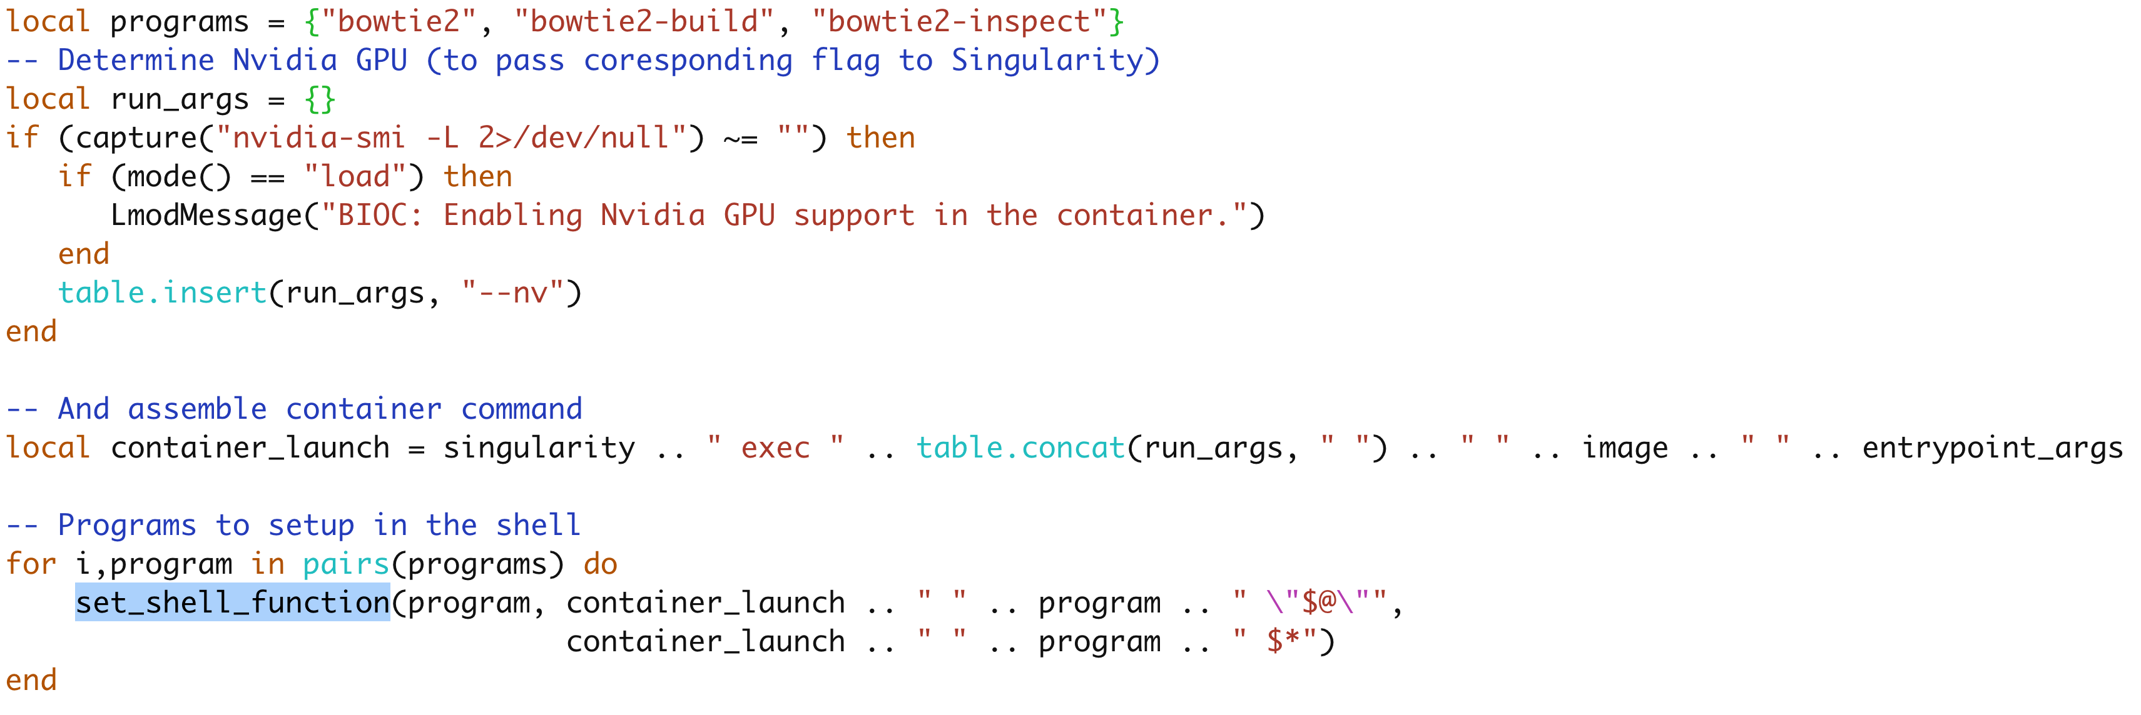
LMOD set_shell_function()

Slide 5
Limitations of set_shell_function()
Container-based modulefiles by Lmod’s set_shell_function() break in MPI and parallel environments.
Shell functions are scoped to the current shell session and are not inherited by subprocesses.
Tools such as mpirun, srun, GNU Parallell or HyperShell spawn new shell instances that do not retain these function definitions.
Defined shell functions will return a command not found error or defaulting to an unintended binary in users’ PATH.

Slide 6
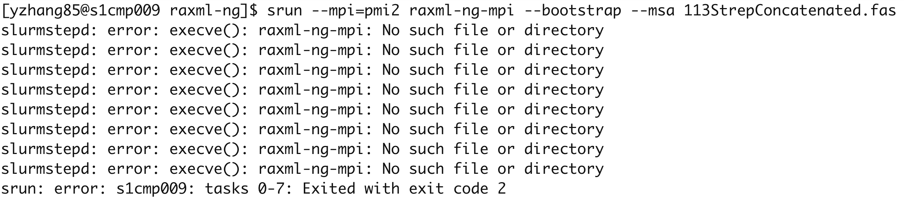
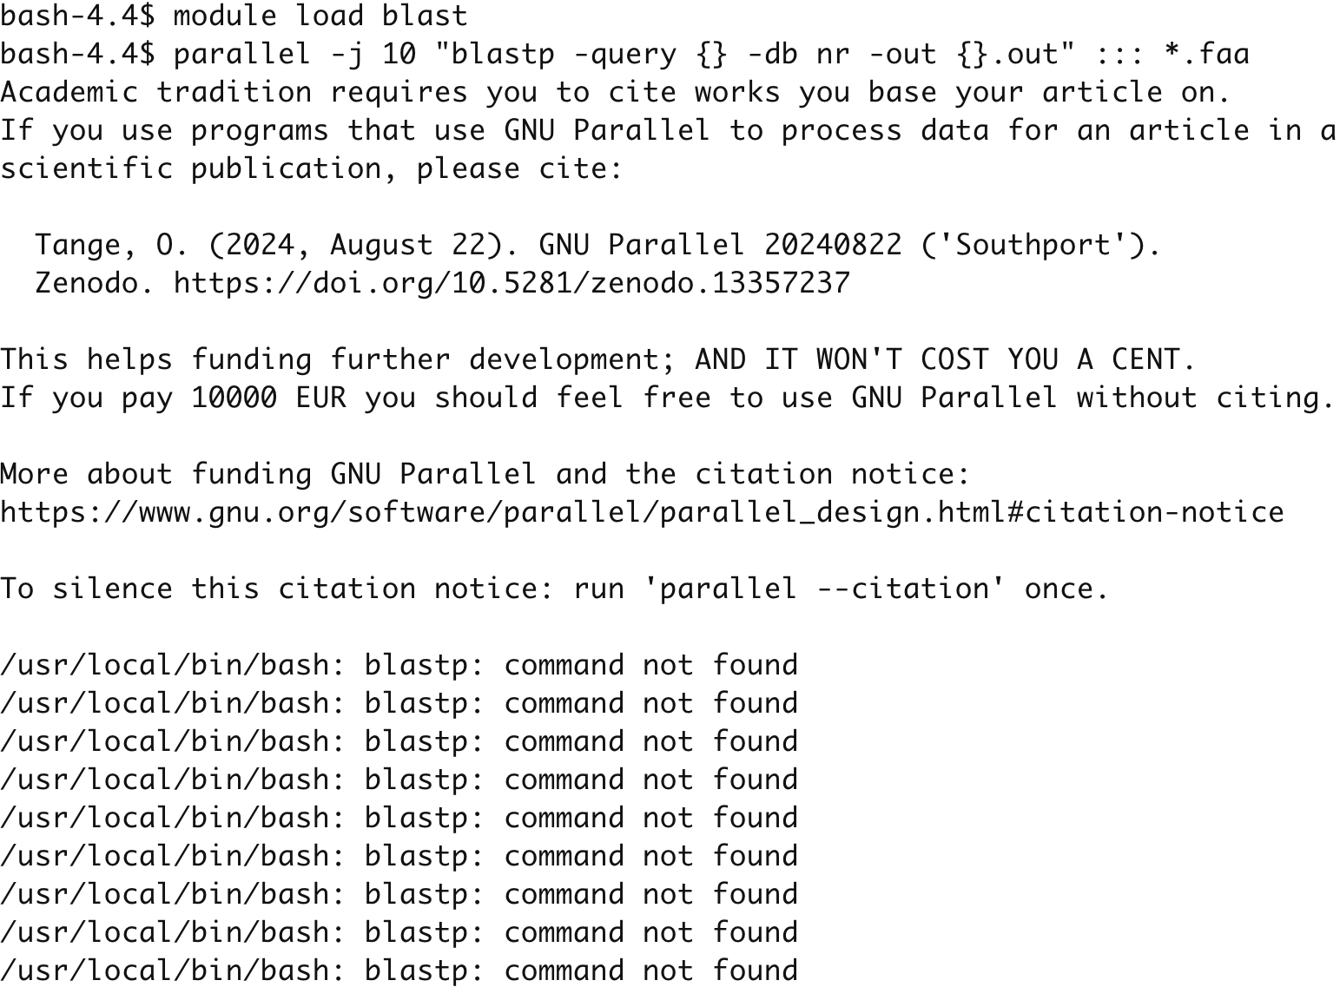
Failure of MPI and parallel jobs

Slide 7
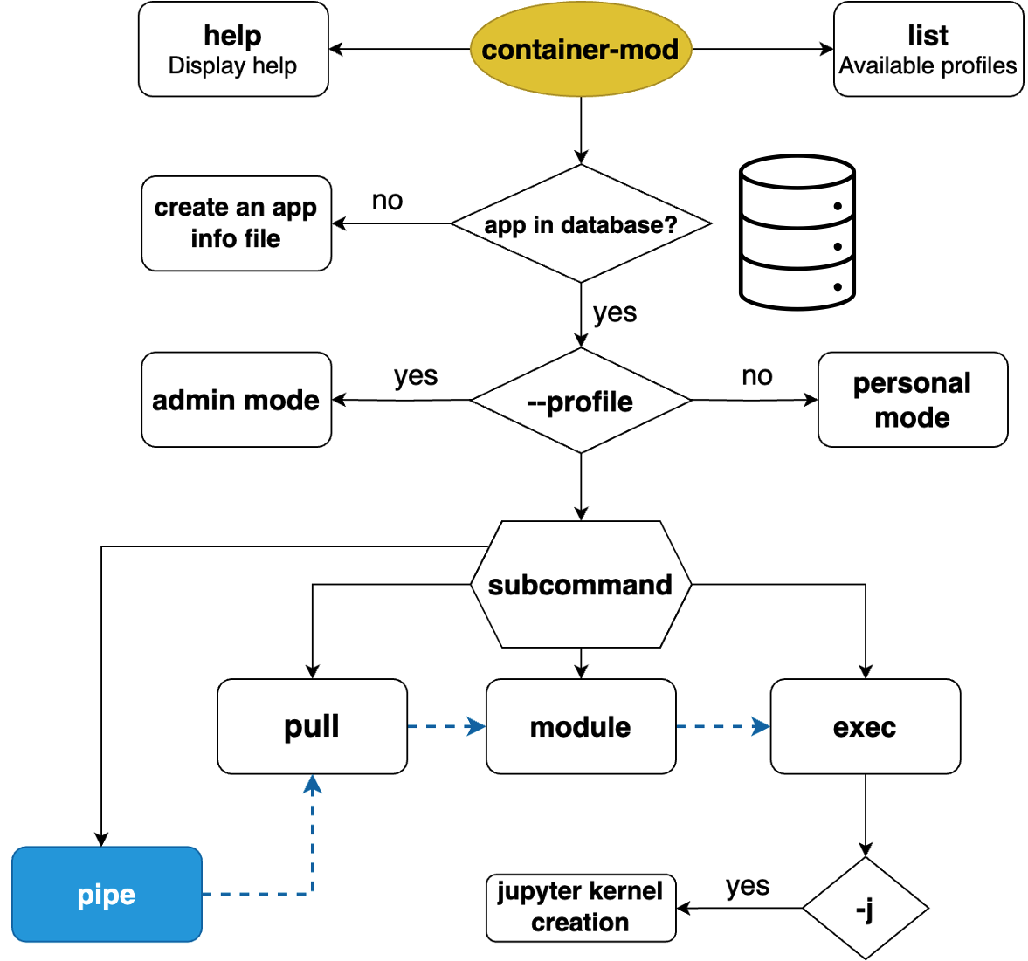


Slide 8
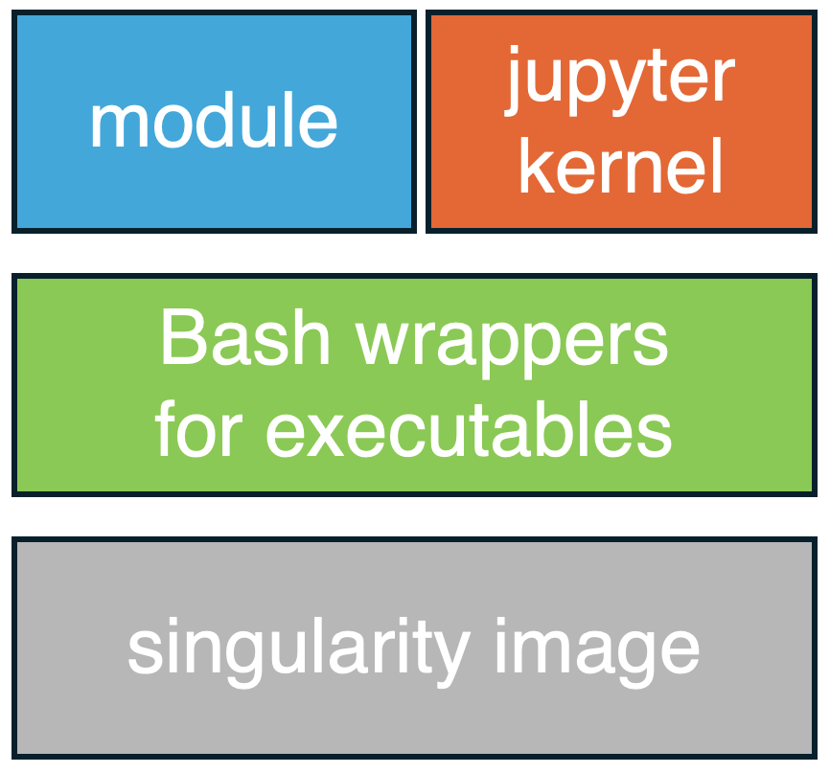
Components

Slide 9
Metadata database for applications
Description: BWA (Burrows-Wheeler Aligner) is a fast, accurate, memory-efficient aligner forshort and long sequencing reads.
Home Page: http://bio-bwa.sourceforge.net
Programs: bwa,qualfa2fq.pl,xa2multi.pl
version("0.7.17", uri="docker://quay.io/biocontainers/bwa:0.7.17--h5bf99c6_8")
Database includes ~700 commonly used scientific applications for HPC

Slide 10
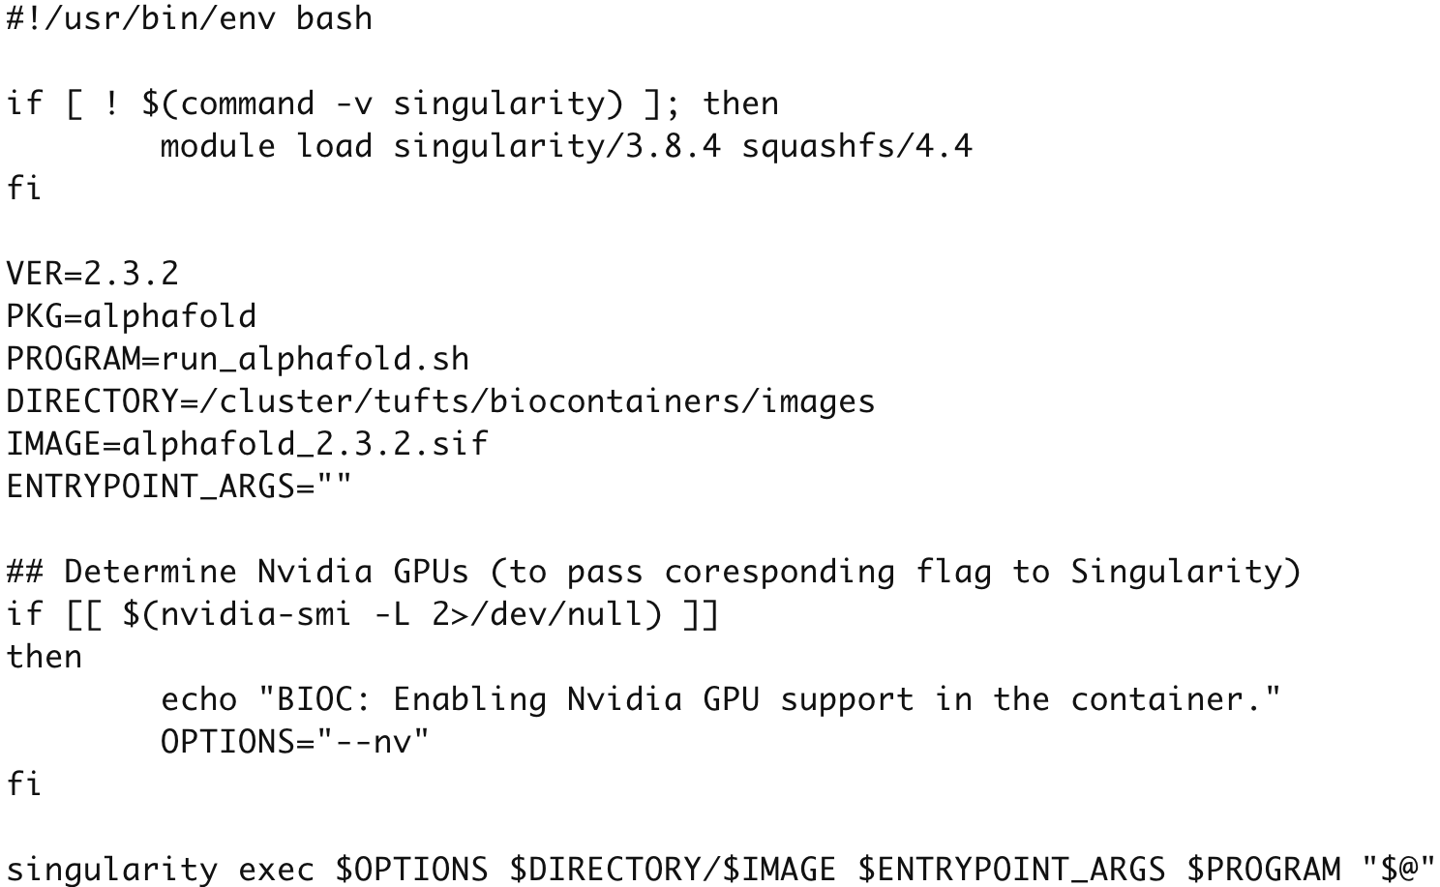
Bash wrappers

Slide 11
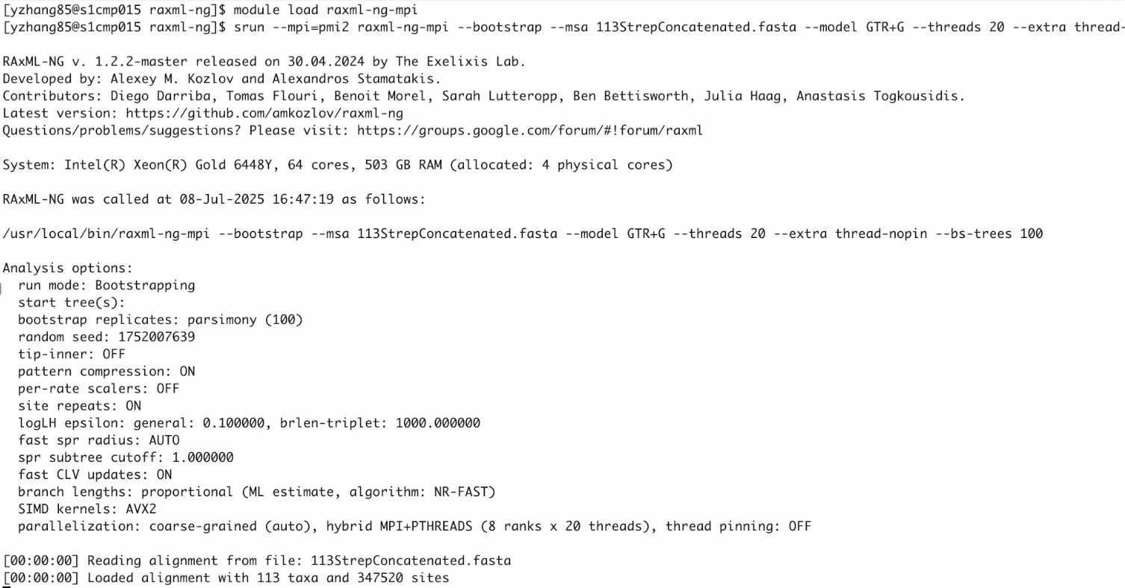
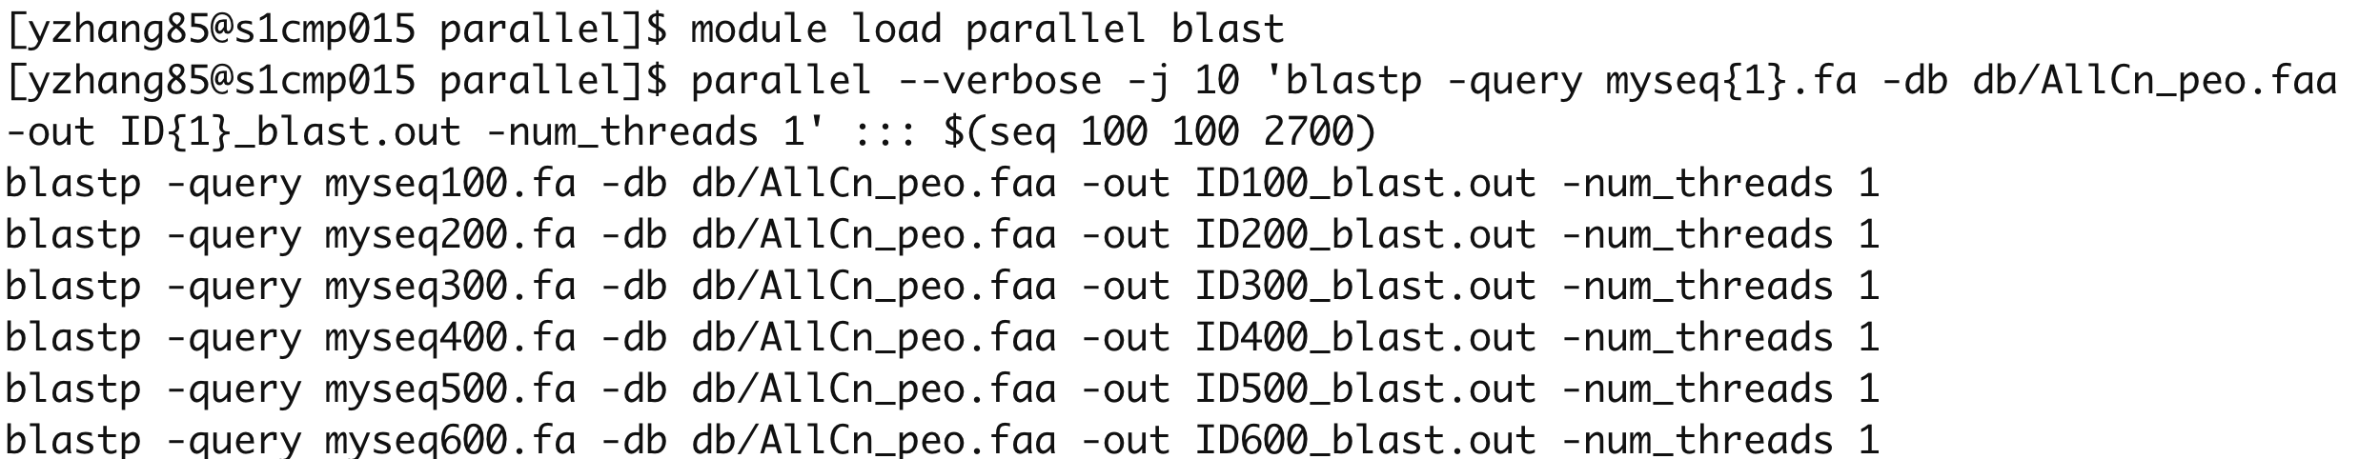
Successful Execution of MPI and Parallel Jobs

Slide 12
Modes
Admin mode: a system administrator or group manager pulls a container for shared use on an HPC system. A profile must be specified, which defines environment variables that control where singularity images and executable wrappers are stored.
Personal mode (default mode): regular users pull containers for personal use, modulefiles are saved in $HOME/privatemodules.

Slide 13
Profiles for Admin Mode
MOD_EXISTING_DIR_DEF=”xxx/modules" # Directory to store ready-to-use modulefiles
PUBLIC_IMAGEDIR=”xxx/images"
PUBLIC_EXECUTABLE_DIR=”xxx/tools"
$ container-mod --list
biocontainers
course_jupyter
ngc

Slide 14
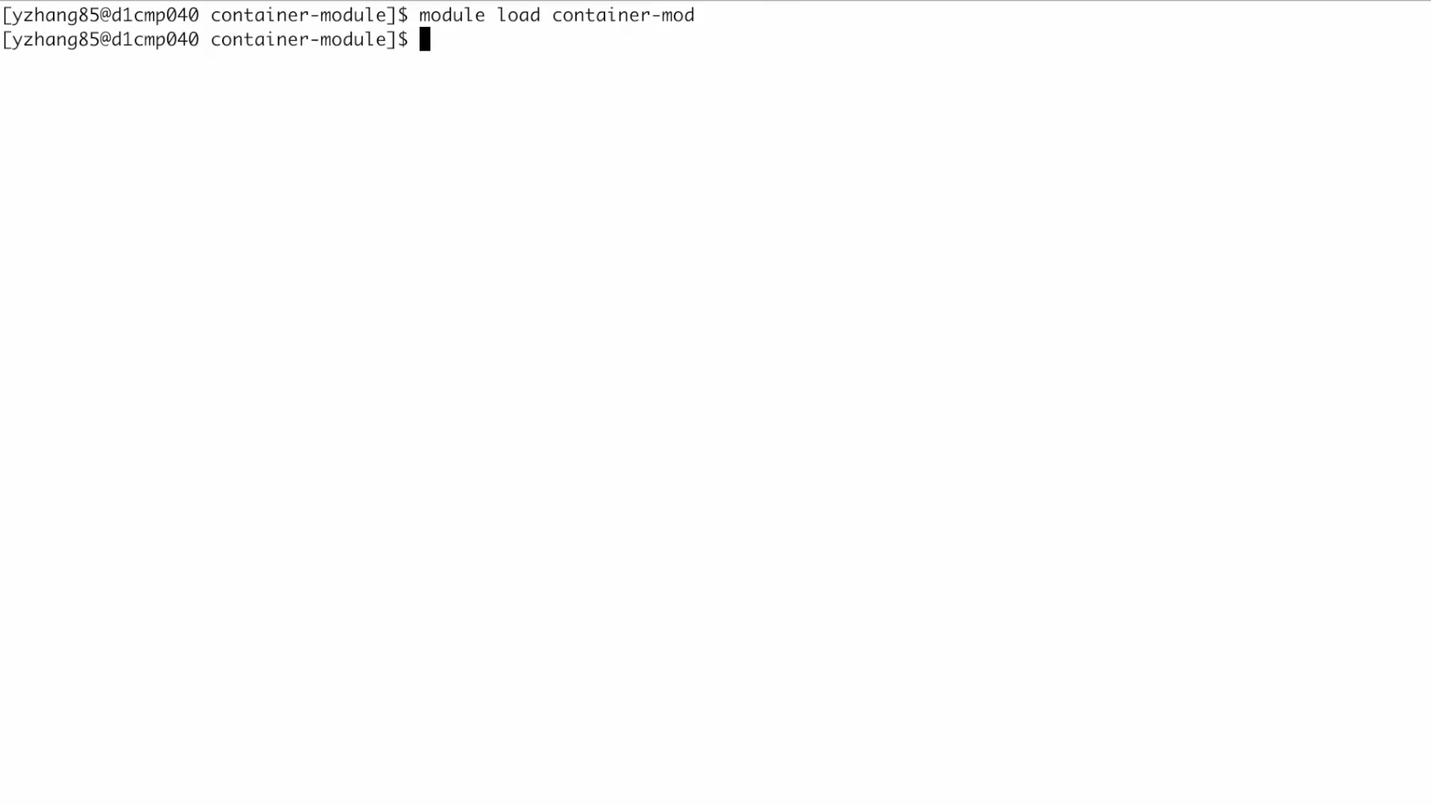
admin mode

Slide 15
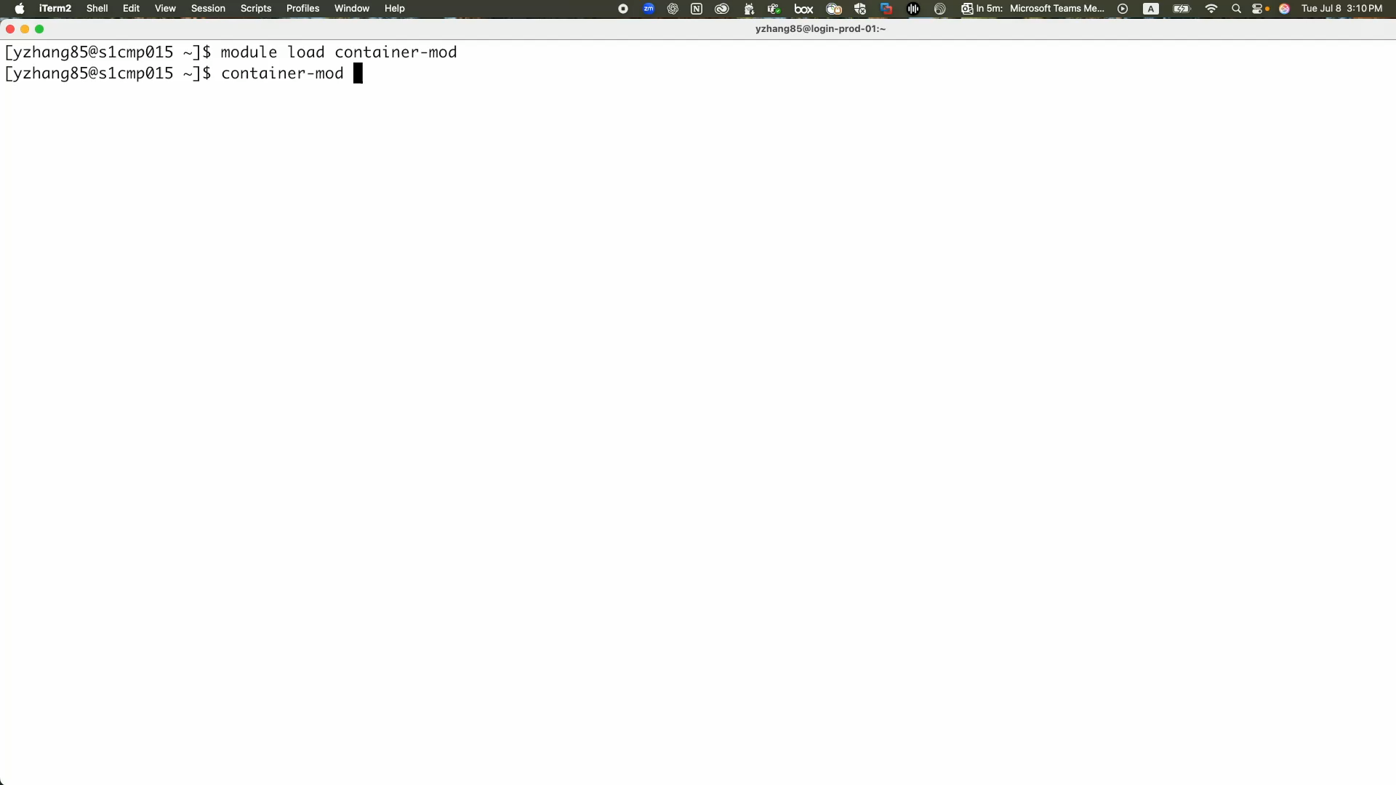
Personal mode and Jupyter

Slide 16
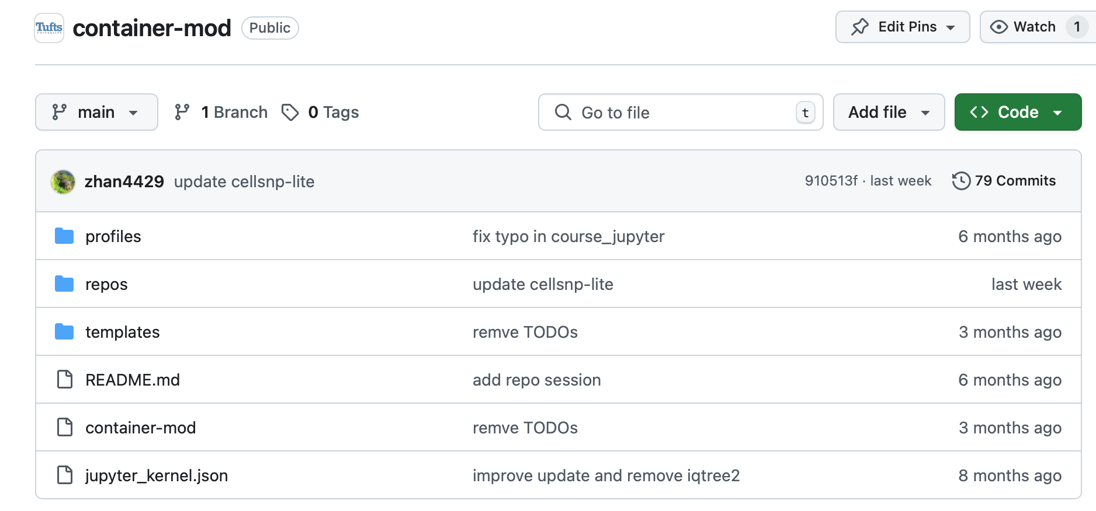
Availability
https://github.com/TuftsRT/container-mod
yucheng.zhang@tufts.edu

Slide 17
Thank you!
PEARC25
Conference Committee
Tufts TTS Research Technology
Patrick Florance
Jay McGlothlin
Kyle Monahan
Christopher Barnet
Delilah Maloney
Xue (Shirley) Li
…

